Slide 1
DengueVac
Get vaccinated before getting bitten !
The 1st serious game to increase dengue vaccination
Sarina Yaghobian, Nisha Gautam, Ted Wong, Jensen Mang
– Health Hack Sydney, Australia – 16 Oct 2016

Slide 2
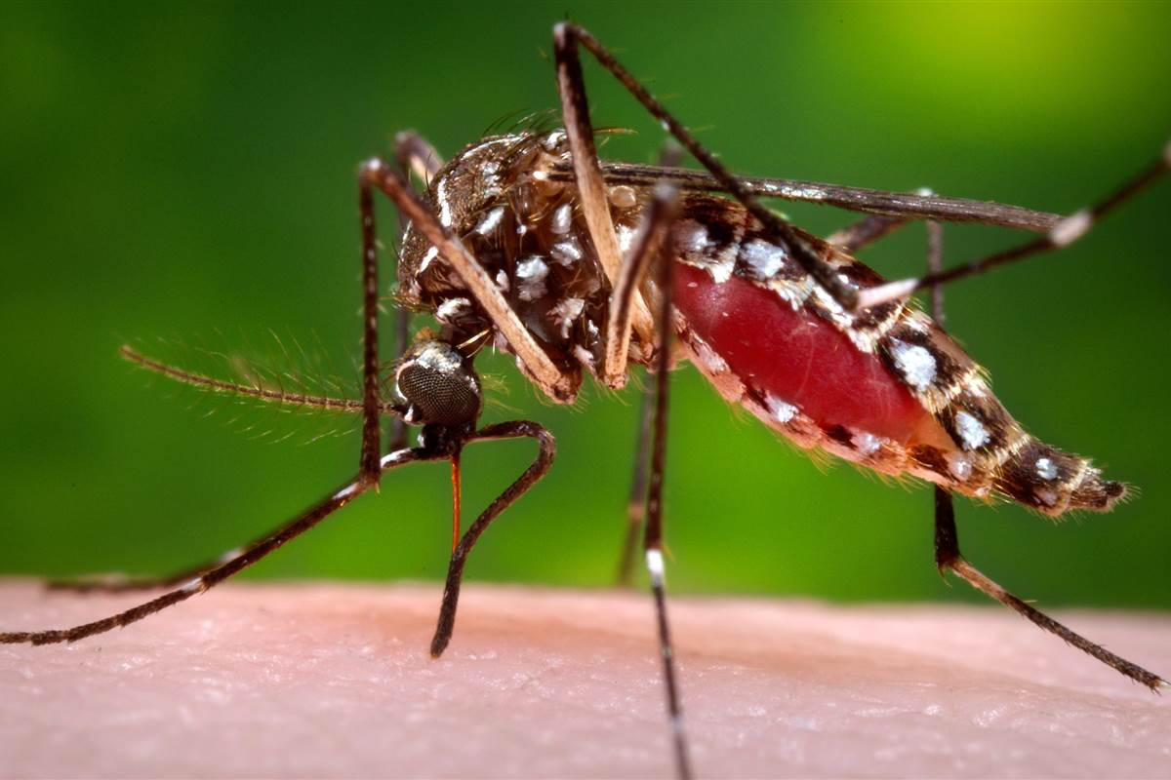
What is Dengue ?
Mosquito-borne viral infection
Flu-like illness to potentially lethal complication
Dramatically increase of cases in recent decades
No treatment
Major global public health problem

Slide 3
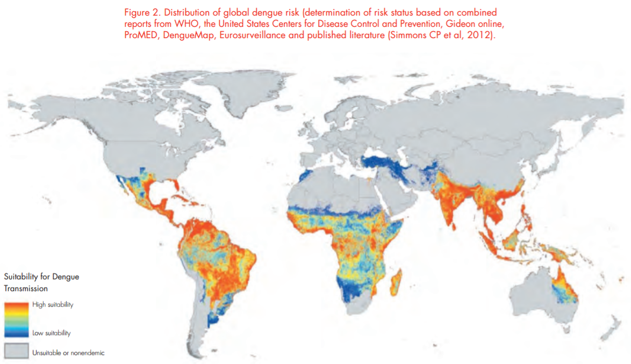
What is the burden of Dengue ?
About half of the world's population is at risk
Estimated 390 million people infected this year
2.5 % of people die
$9 billion (US) cost

Slide 4
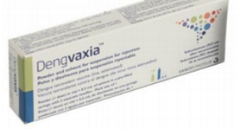
What is planned to prevent Dengue ?
Reduce mortality by 50% and morbidity by 25% by 2020
Vector control
Vaccine introduction
Communication to achieve behavioral outcomes

Slide 5
What can WE do to prevent Dengue ?
DengueVac: The 1st serious game to increase dengue vaccination
Designed for children and parents
Educational and Entertaining
Positive Influence on Vaccination Behaviour
Provide UNDERSTANDING and ACCEPTANCE to get dengue vaccinated

Slide 6
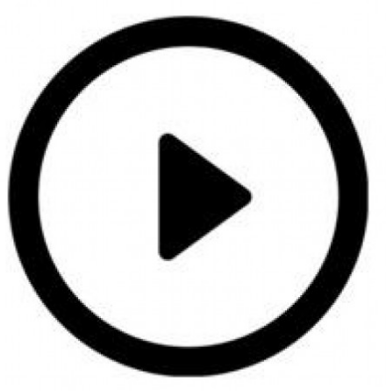
How does it work ?
Let’s play the game !

Slide 7
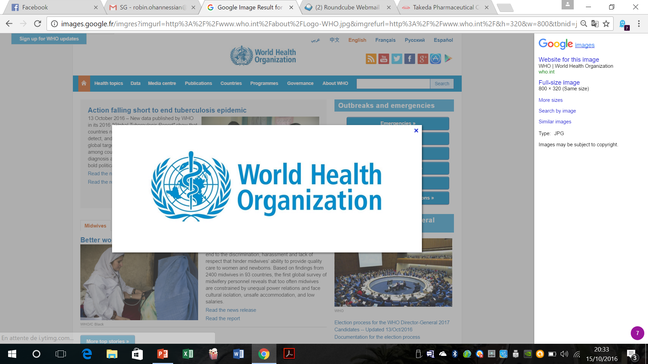
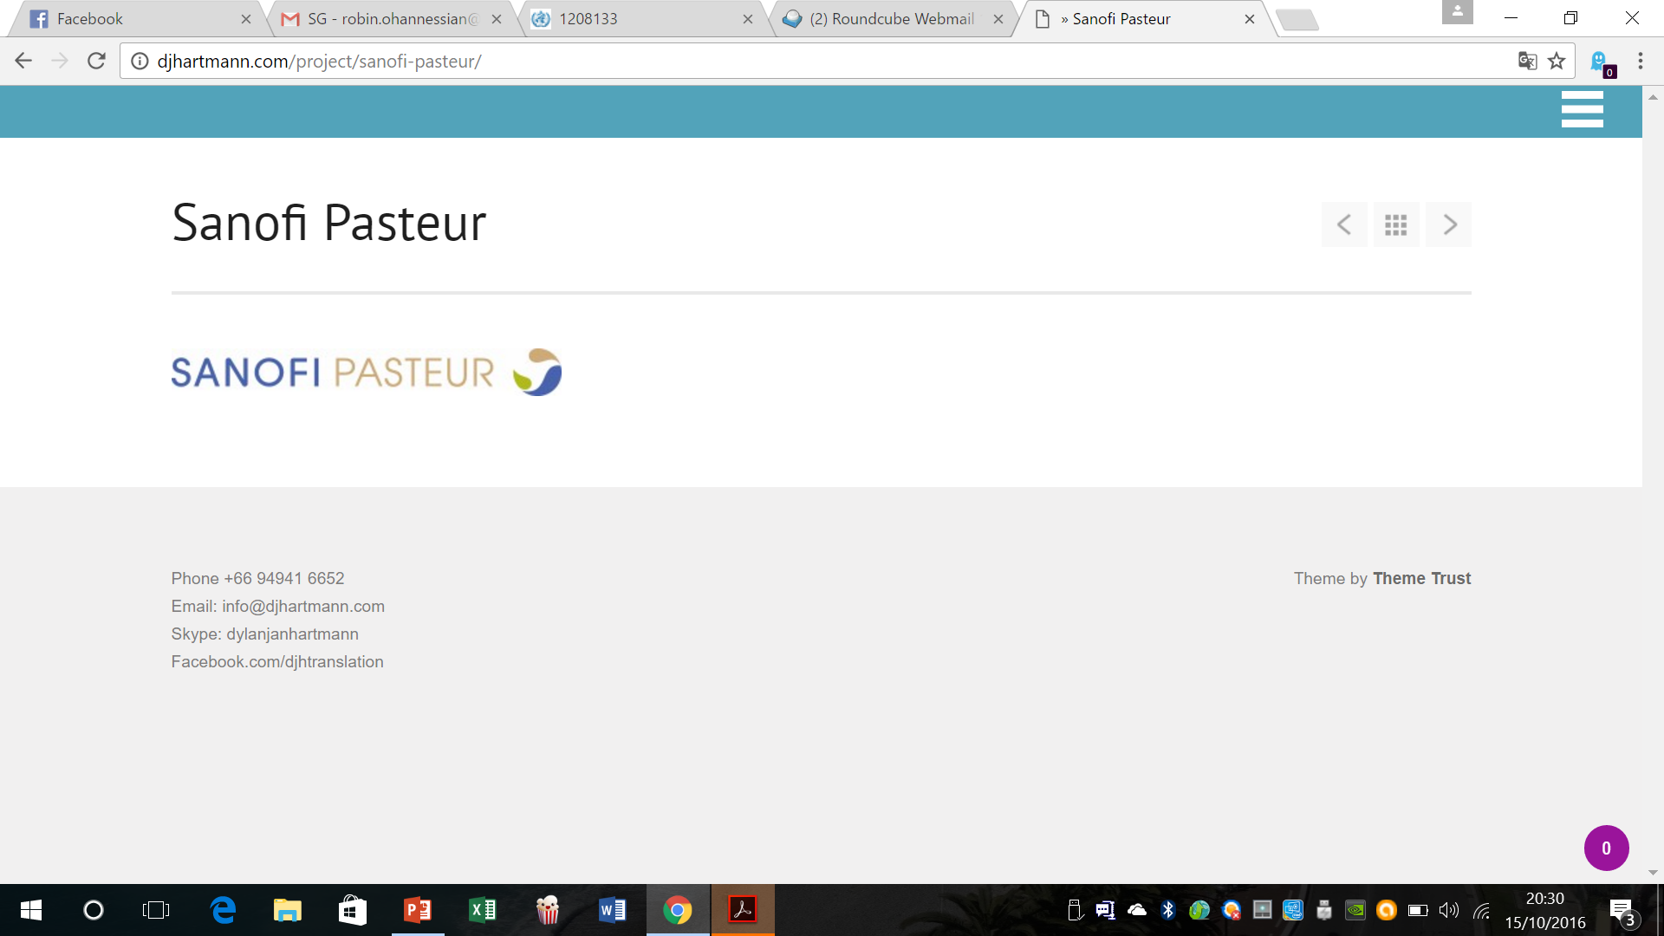
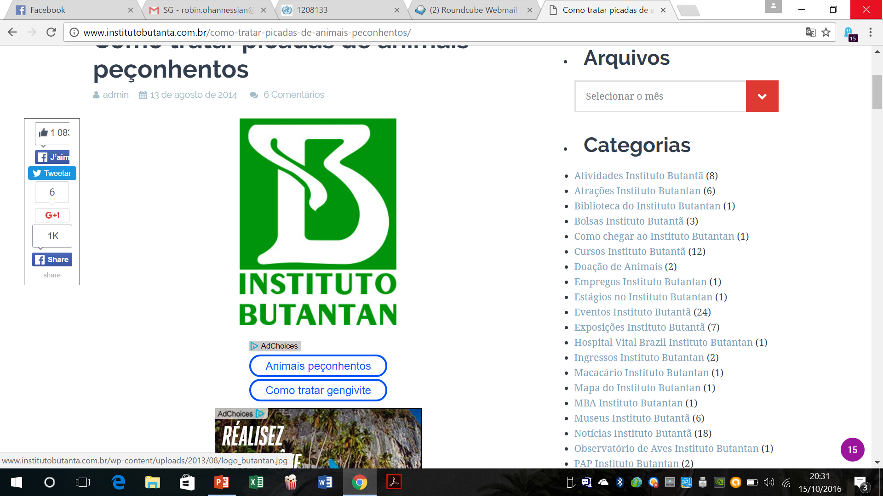
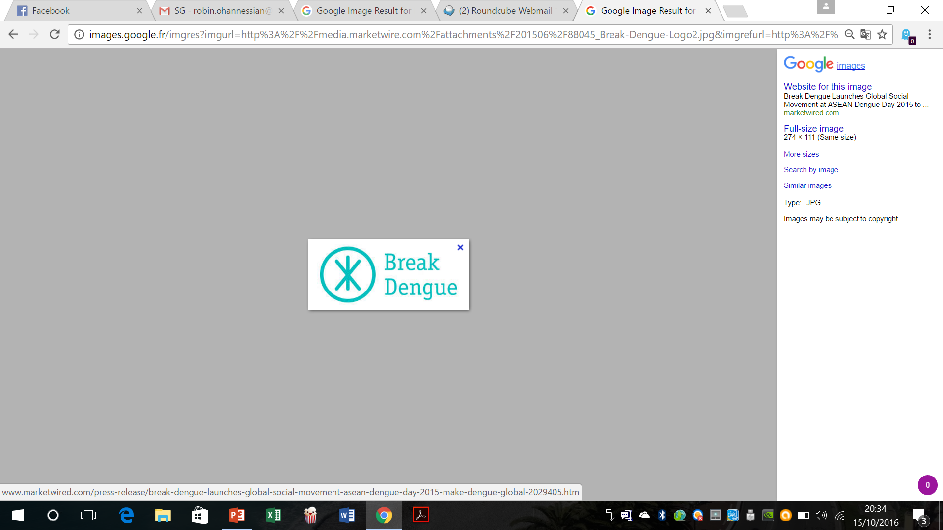
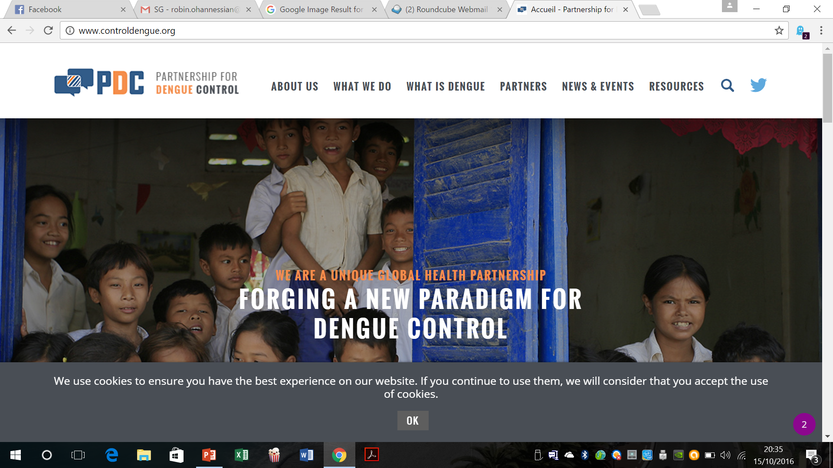
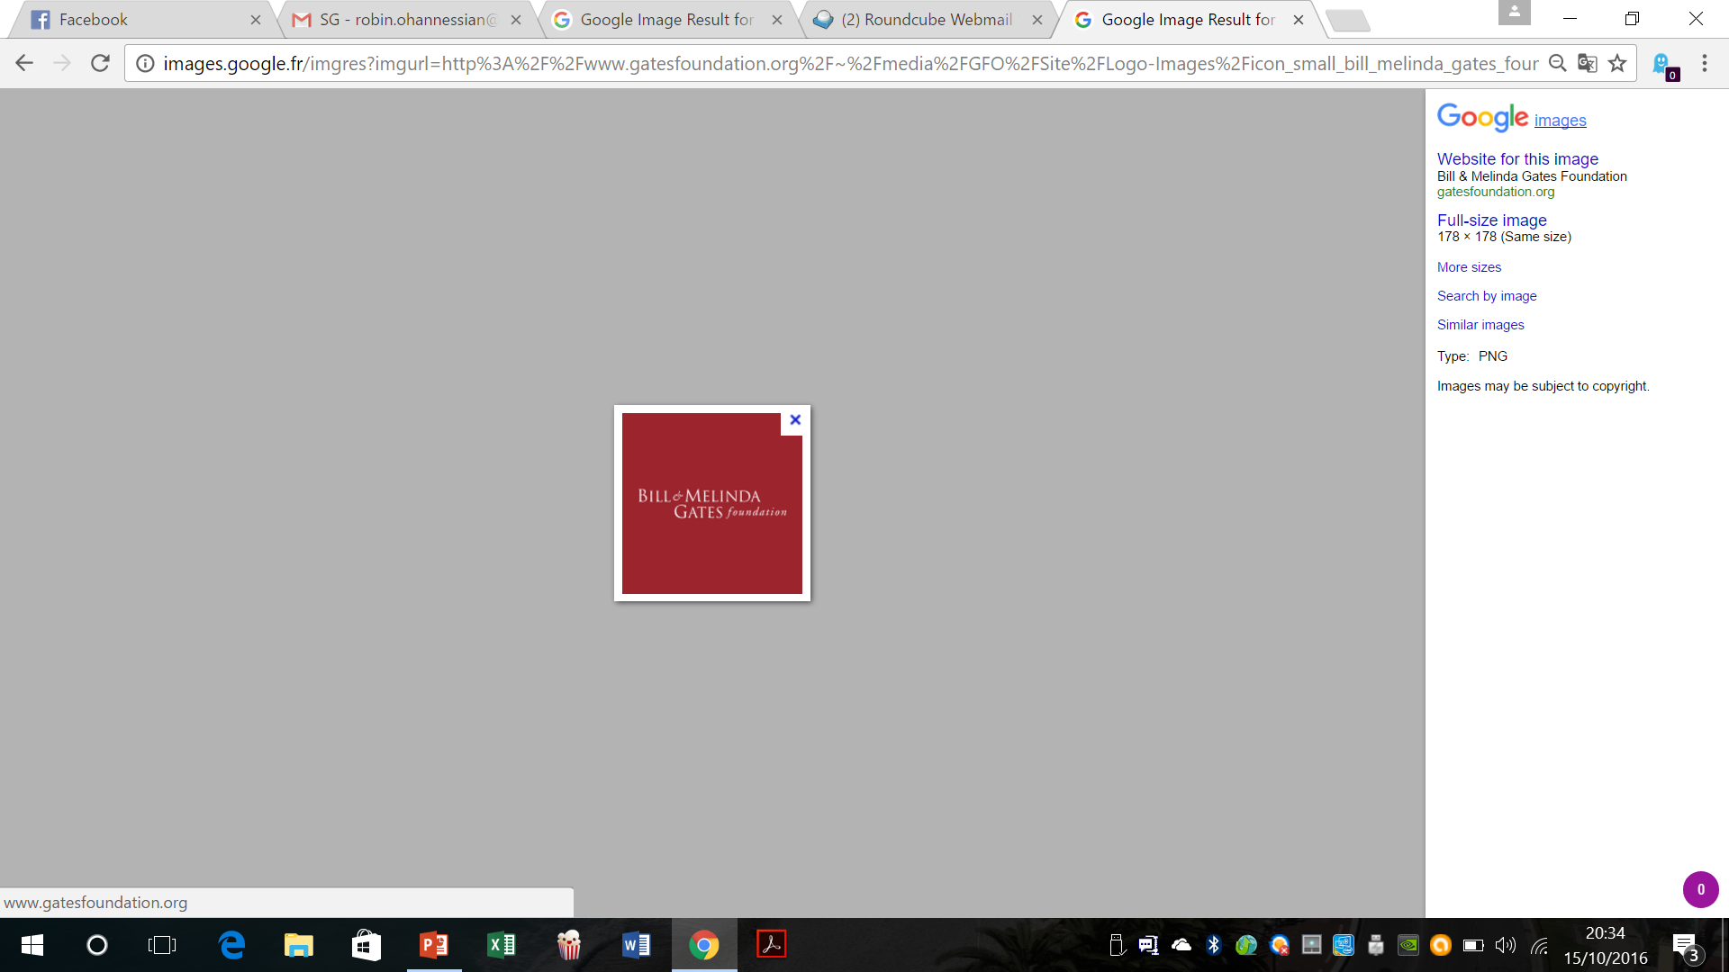
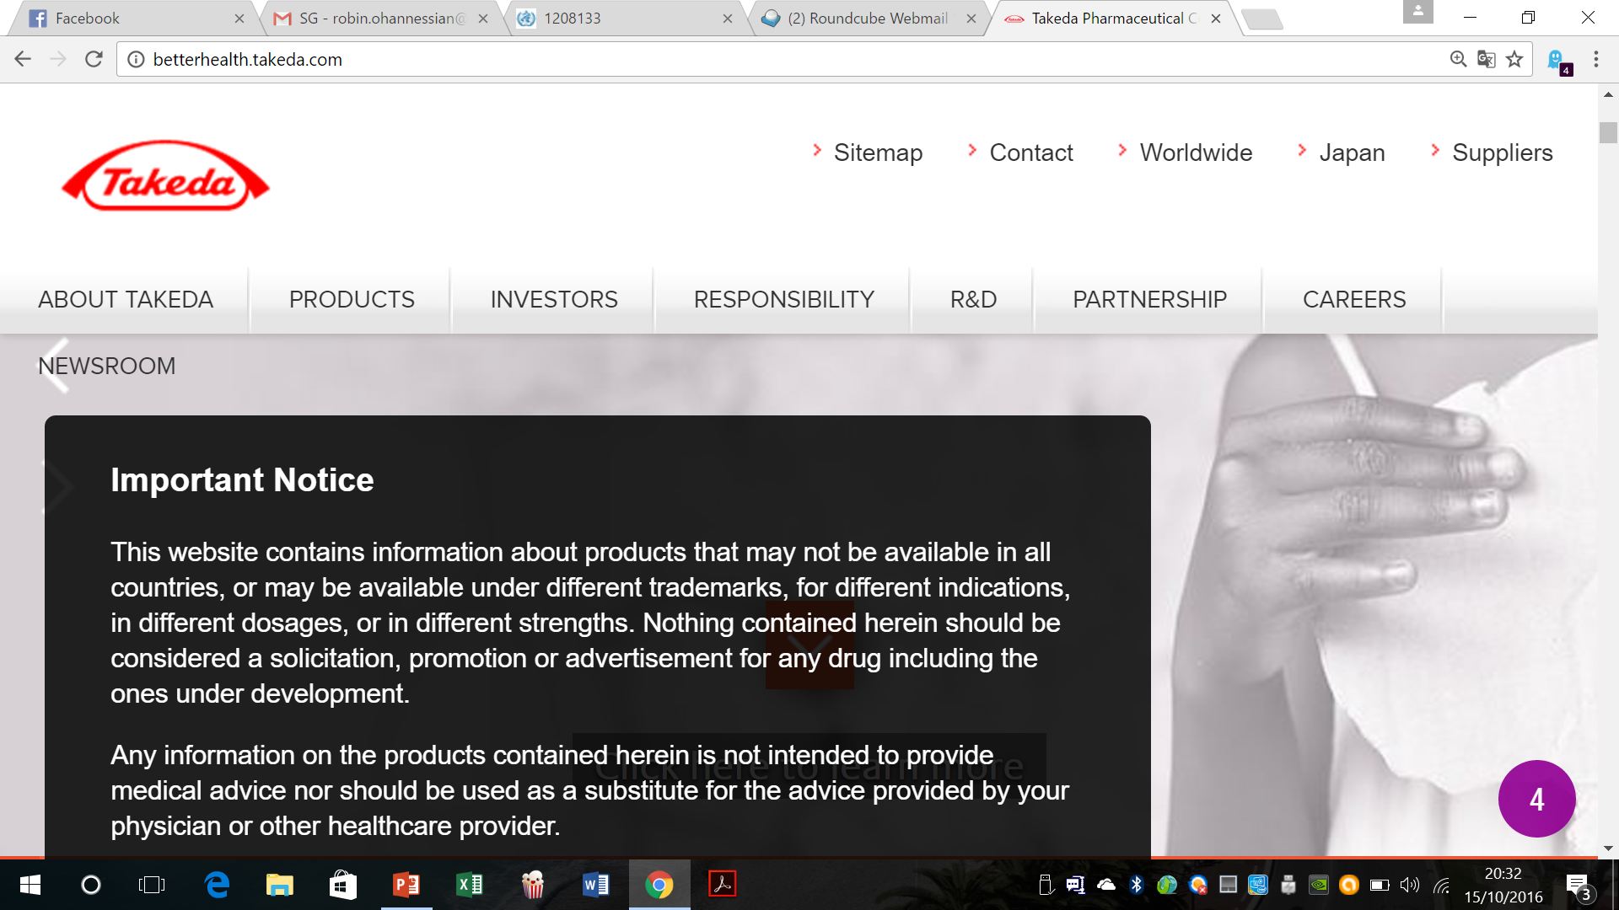
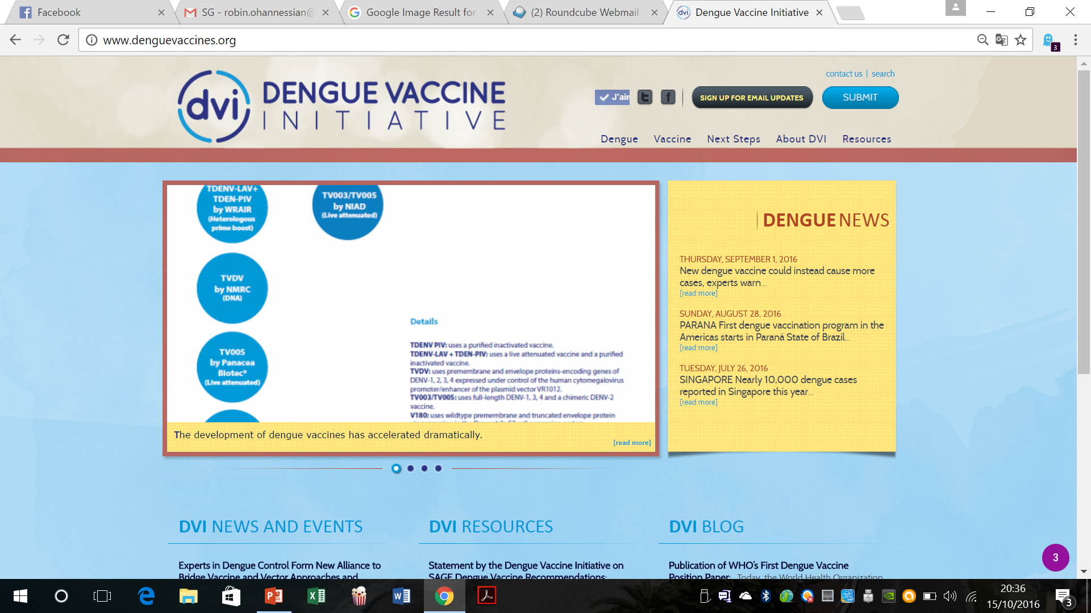
Who might be interested ?

Slide 8
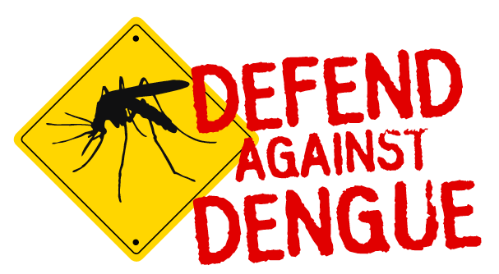
Thank you

